Slide 1

An introduction on Self-supervised Learning
Presented by M.-D. Nguyen Pusan National University
November 8th, 2023

Slide 2
Table of contents
Introduction
Motivations and Applications
General Architecture
Subcategory
Day 1
Contrastive Learning
SimCLR
Redundancy Reduction
Barlow Twins
VICReg
MetaMask
Day 2
Invariance Learning
Laplace-GGN

Slide 3
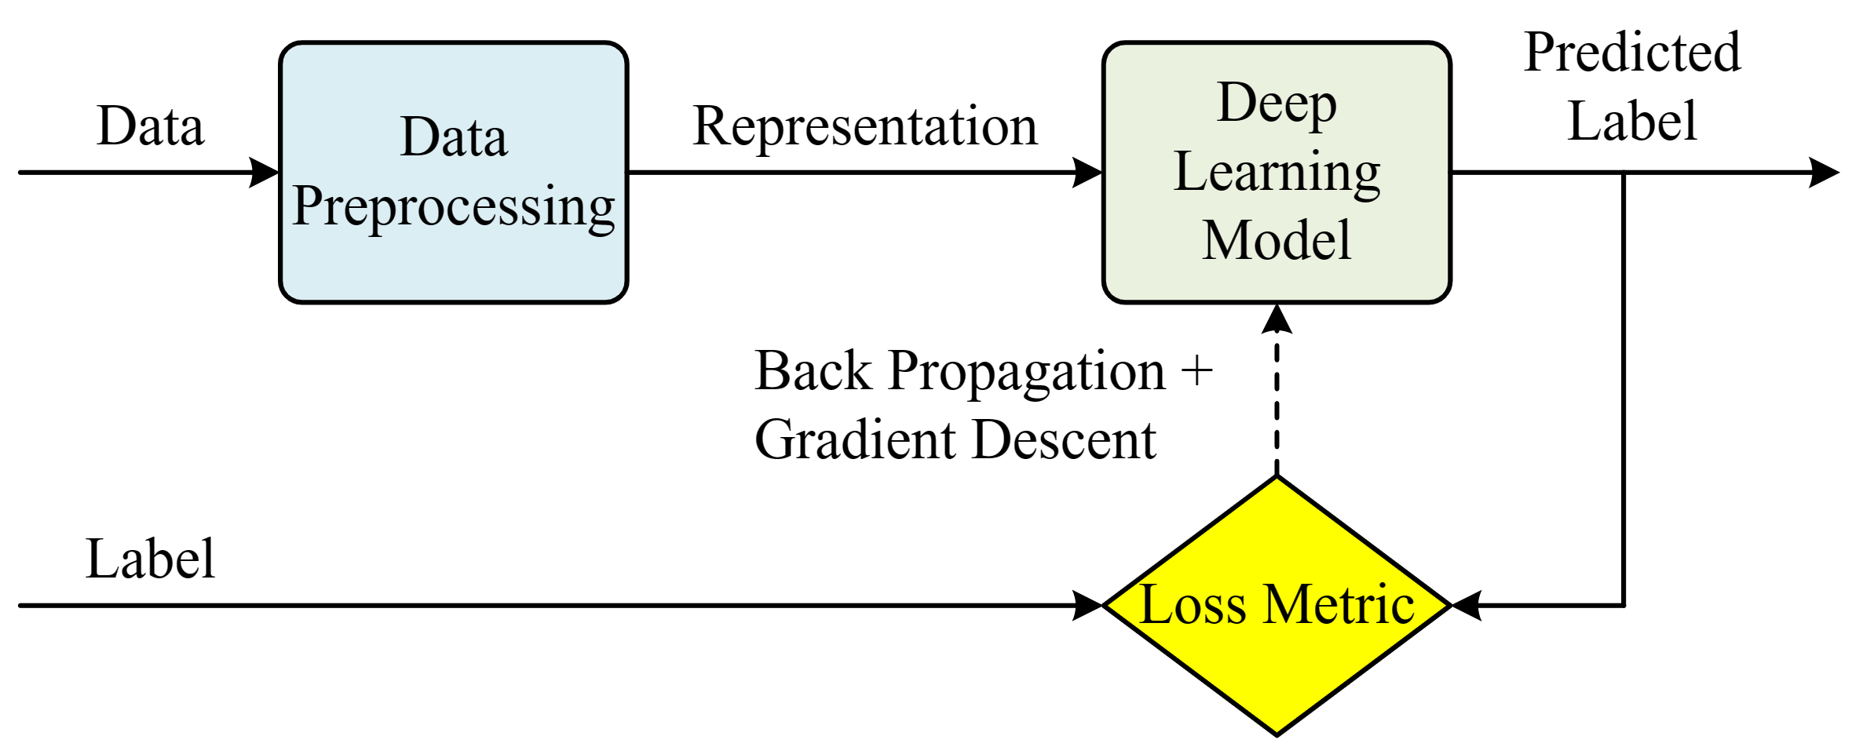
1. Introduction: Motivations - General AI Architecture
Data Preprocessing:
Remove redundant information
Reduce noise
Capture essential, semantically meaningful patterns
Deep Learning Model:
Predict the data label based on the AI task
Loss Metric:
Leverage the Predicted Label and Label to measure the Loss
Calculate the Gradient Descent to update AI Model
→ The Self-supervised Learning (SSL) is located at the data preprocessing block

Slide 4
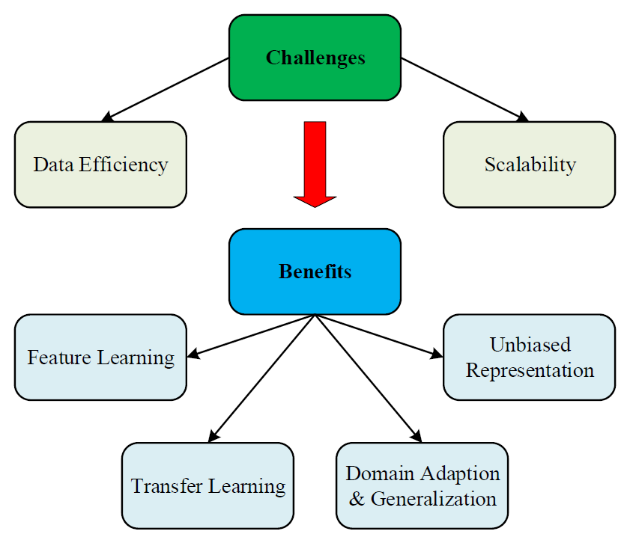
1. Introduction: Motivations
Challenges:
Data Efficiency: annotating data with label is time-consuming and expensive
Scalability: data exponentially grow overtime
Benefits:
Feature Learning: extract rich meaningful features from raw data → reduces computation cost for DL Model
Transfer Learning: provide strong representations that can be adapted to a wide range of downstream tasks
Domain Adaptation & Generalization: help adapt models to new domains or tasks without the need for labeled data
Unbiased Representation: offer more unbiased, domain independent representations

Slide 5
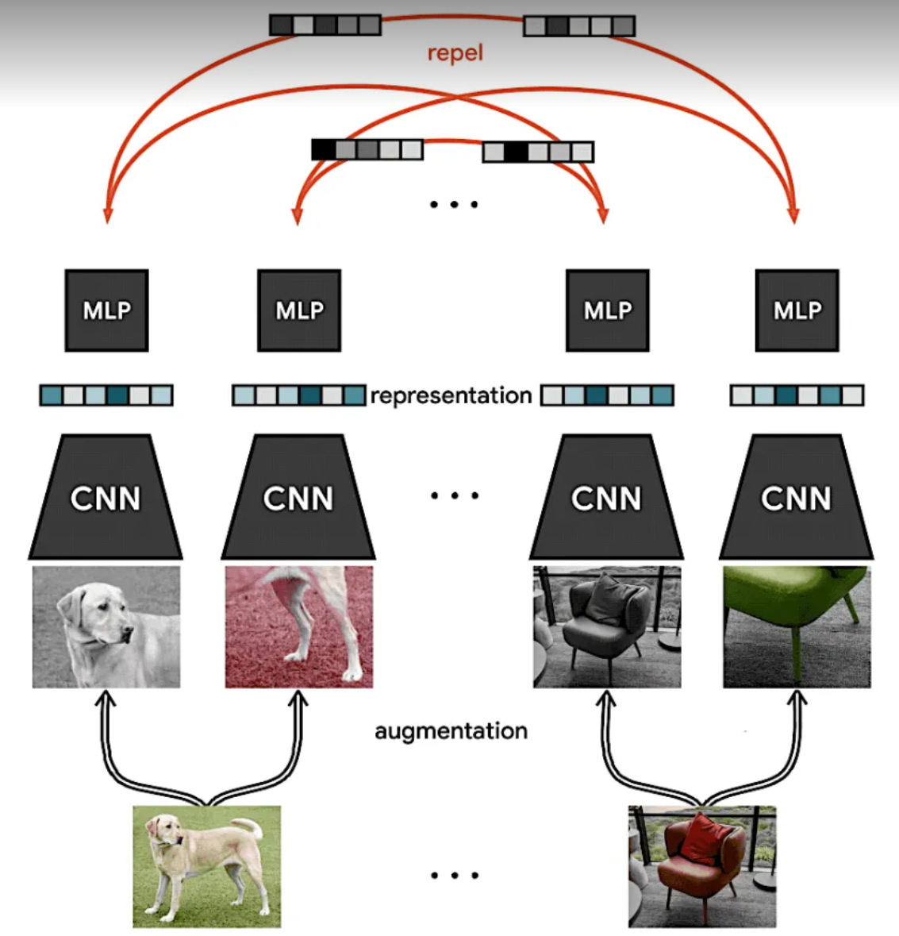
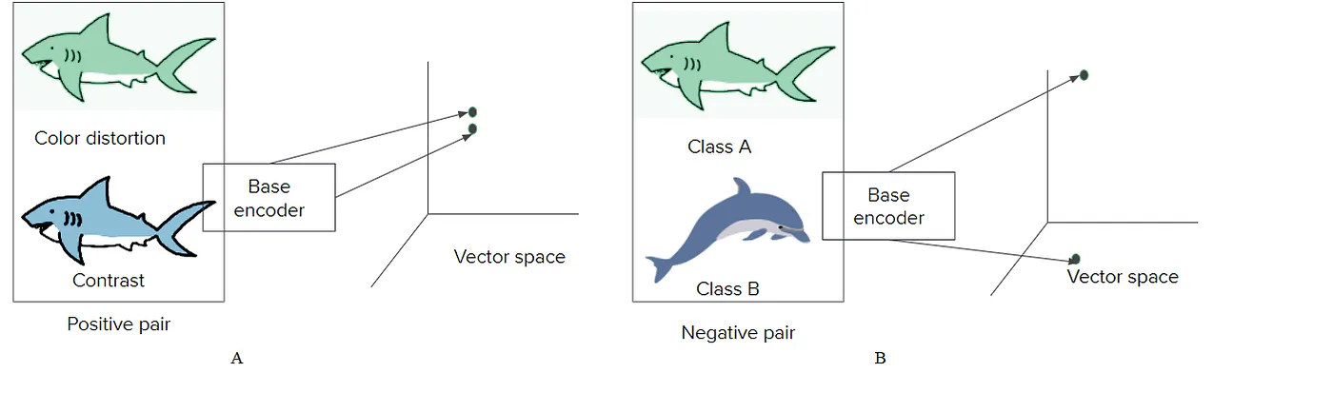
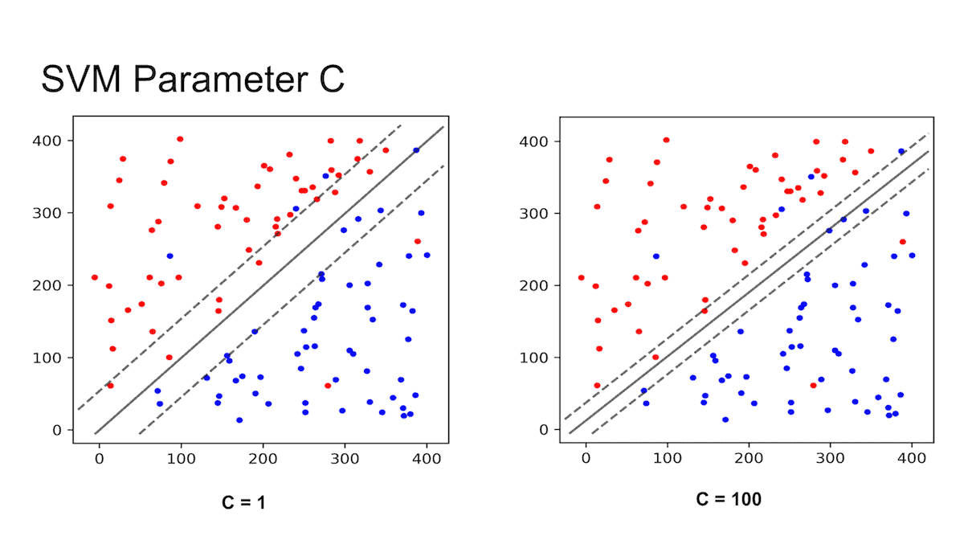
1. Introduction: Applications
Feature Learning:
Data is more classified → AI model needs less computation requirements.

Slide 6
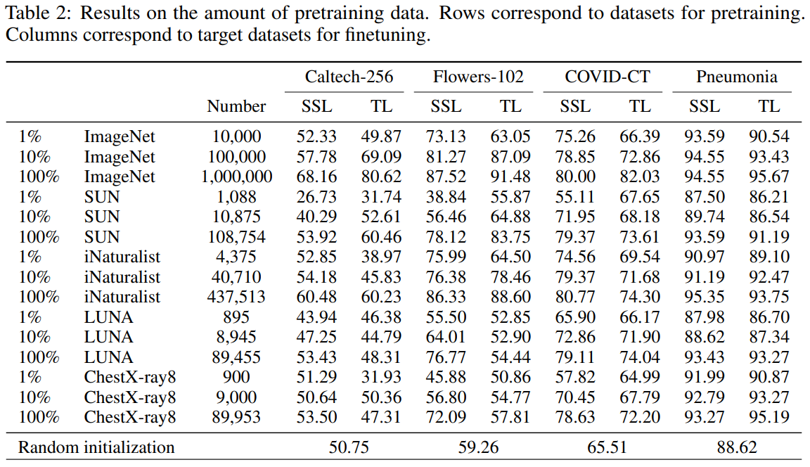
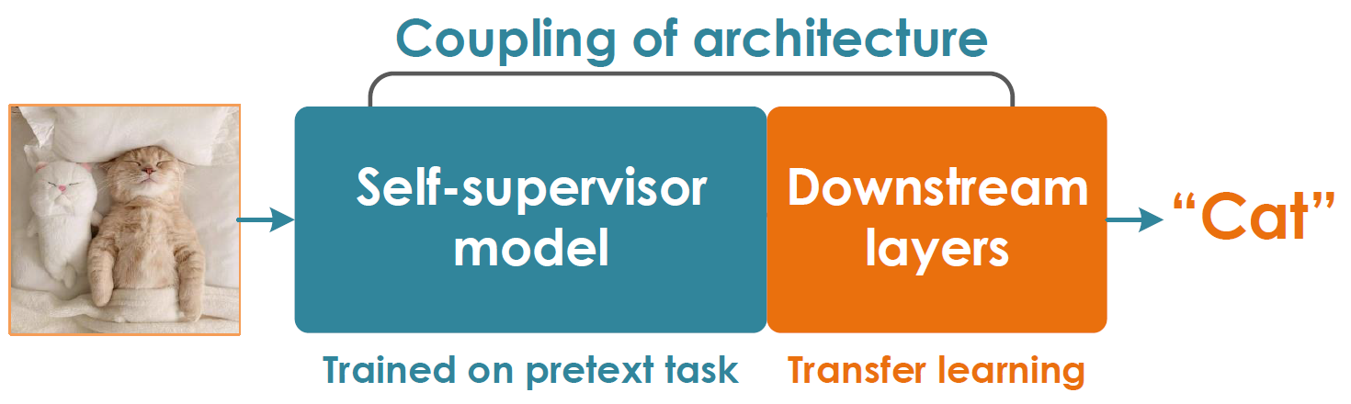
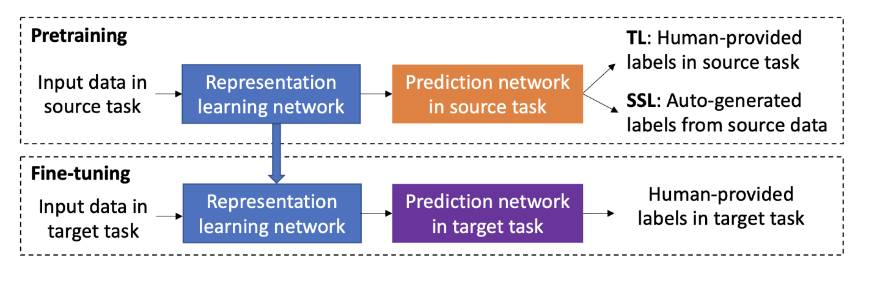
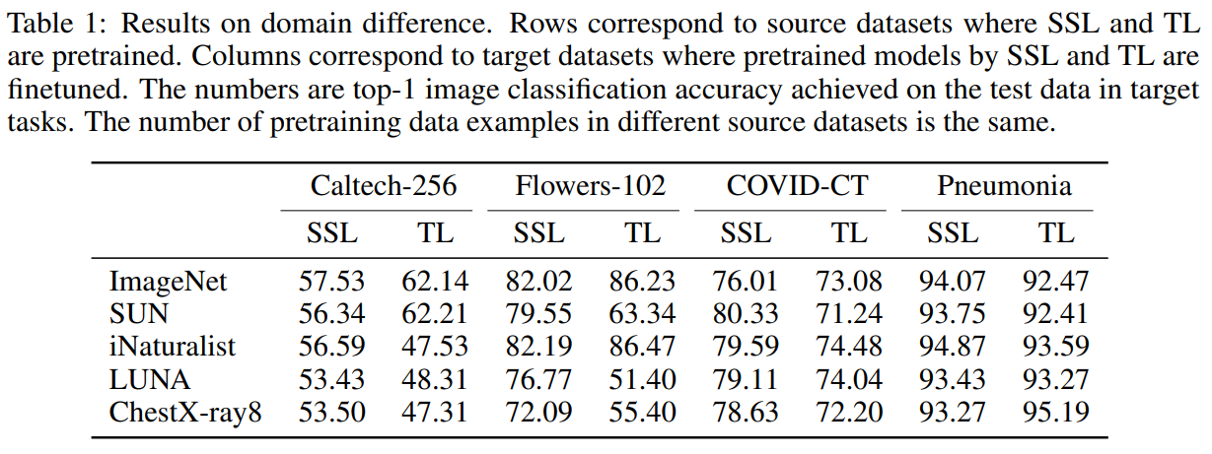
1. Introduction: Applications
Transfer Learning: provide strong representations that can be adapted to a wide range of downstream tasks.
[*] Xingyi Yang, Xuehai He, Yuxiao Liang, Yue Yang, Shanghang Zhang, Pengtao Xie, “Transfer Learning or Self-supervised Learning? A Tale of Two Pretraining Paradigms”, Arxiv, arxiv.org/abs/2007.04234

Slide 7
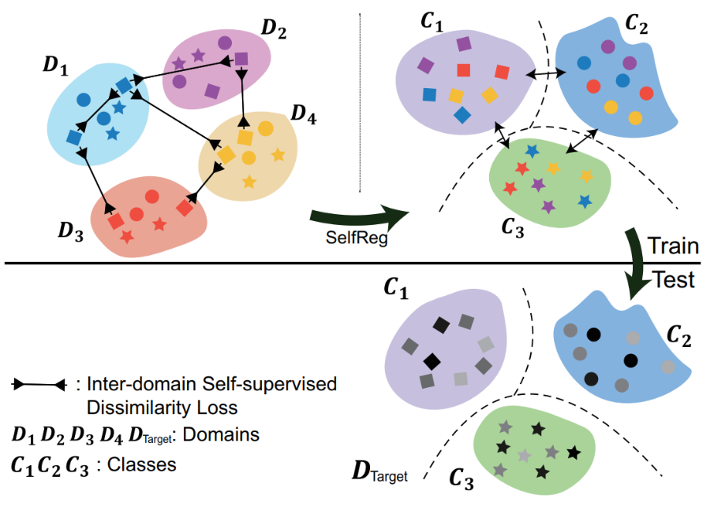
1. Introduction: Applications
Domain Adaptation & Generalization: help adapt models to new domains or tasks without the need for labeled data.
Contrastive losses maps latent representations of the same-class samples close together.
Learn domain-invariant representation
→ Improves Domain Generalization among domains.
[*] Daehee Kim, Youngjun Yoo, Seunghyun Park, Jinkyu Kim, Jaekoo Lee, “SelfReg: Self-supervised Contrastive Regularization for Domain Generalization”, ICCV, 2021.

Slide 8
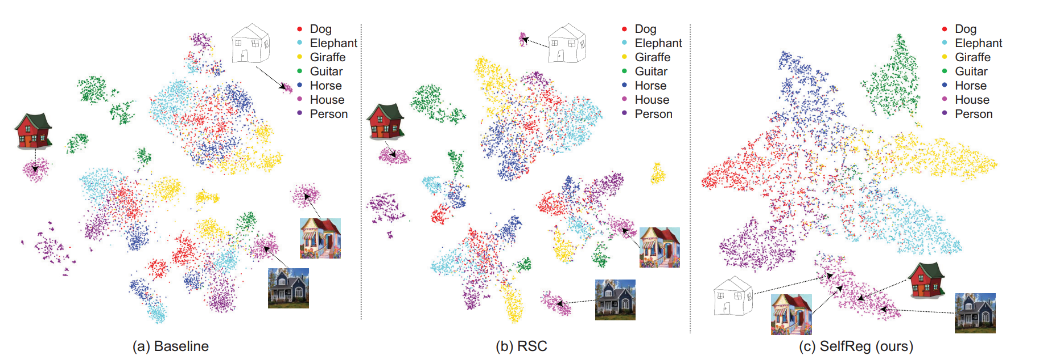
1. Introduction: Applications
[*] Daehee Kim, Youngjun Yoo, Seunghyun Park, Jinkyu Kim, Jaekoo Lee, “SelfReg: Self-supervised Contrastive Regularization for Domain Generalization”, ICCV, 2021.

Slide 9
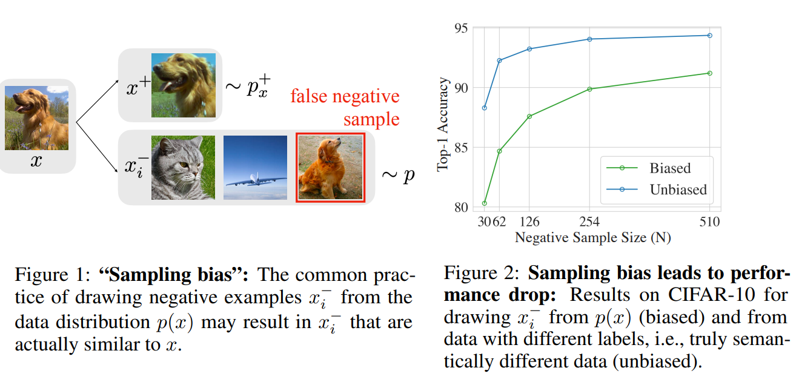
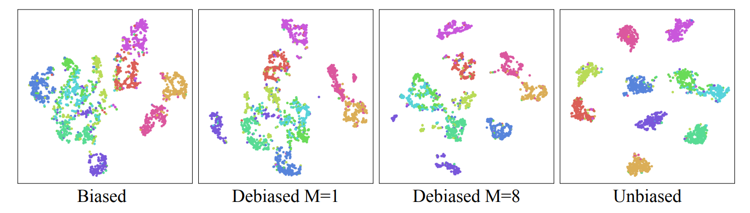
1. Introduction: Applications
Biased sampling leads to the reduction in AI performance.
Unbiased Representation: offer more unbiased, domain independent representations.
[*] Ching-Yao Chuang, Joshua Robinson, Lin Yen-Chen, Antonio Torralba, Stefanie Jegelka, “Debiased Contrastive Learning”, NeurIPS, 2020.

Slide 10
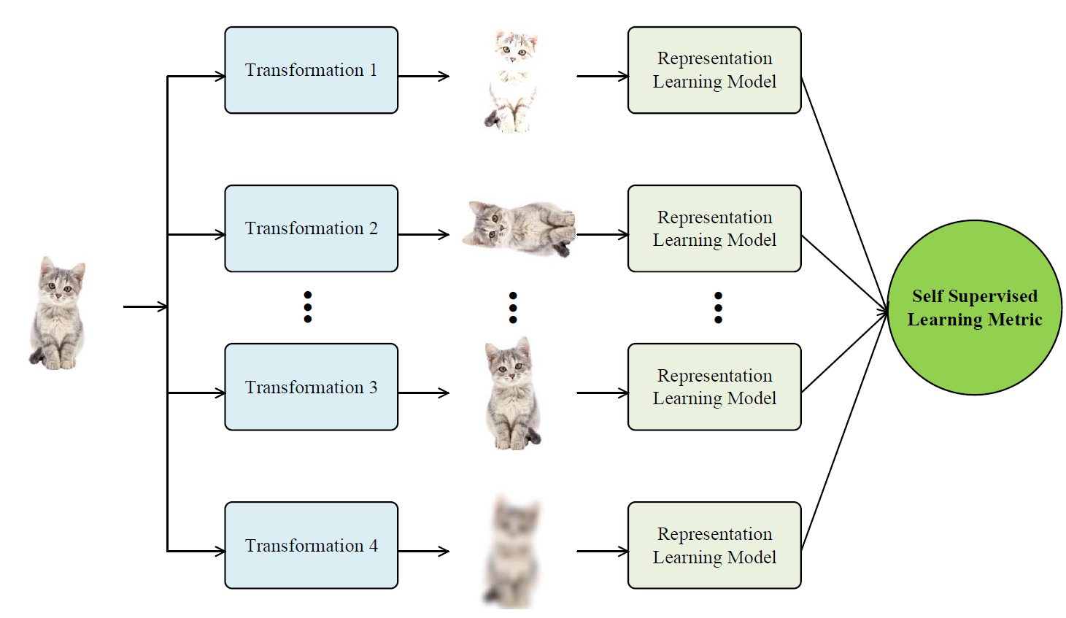
1. Introduction: General Architecture
Transformation Model:
Transformation block has the objective of generating different perturbations for the data.
Different perturbations give different points of view, which leads to different information.
Representation Learning Model:
The deep learning (DL) model that handles different views of data at once.
Self-supervised Learning Metric: loss functions to:
Learn the salient features among views.
Reduces noisy/redundant information.

Slide 11
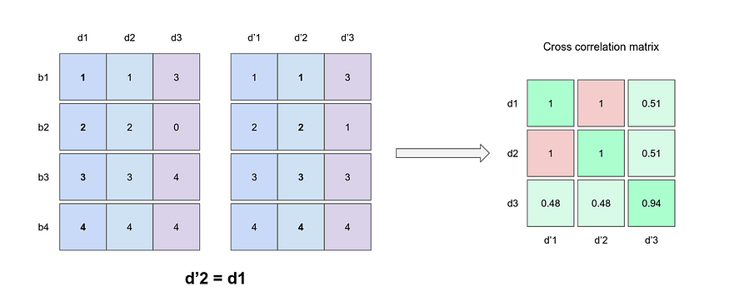
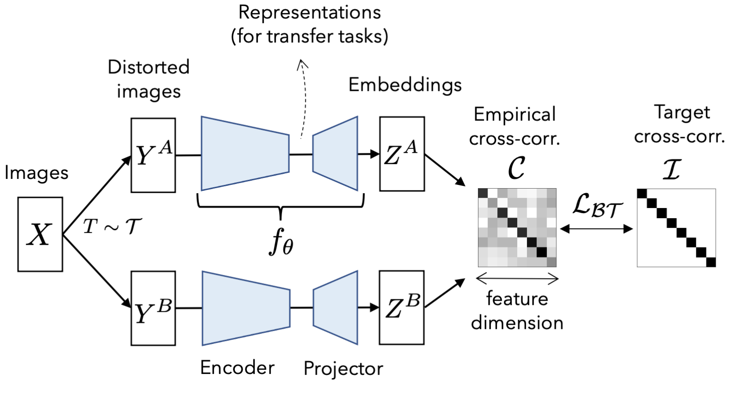
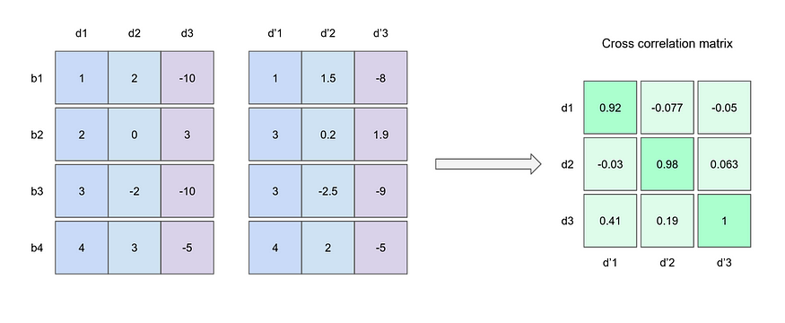
1. Introduction: Subcategory-Redundancy Reduction
Redundancy Reduction: reduces the information while maintaining the meaningful information of the data.
Significant Researches:
Barlow Twins
VICReg
Redundant Embeddings
Non-redundant Embeddings

Slide 12
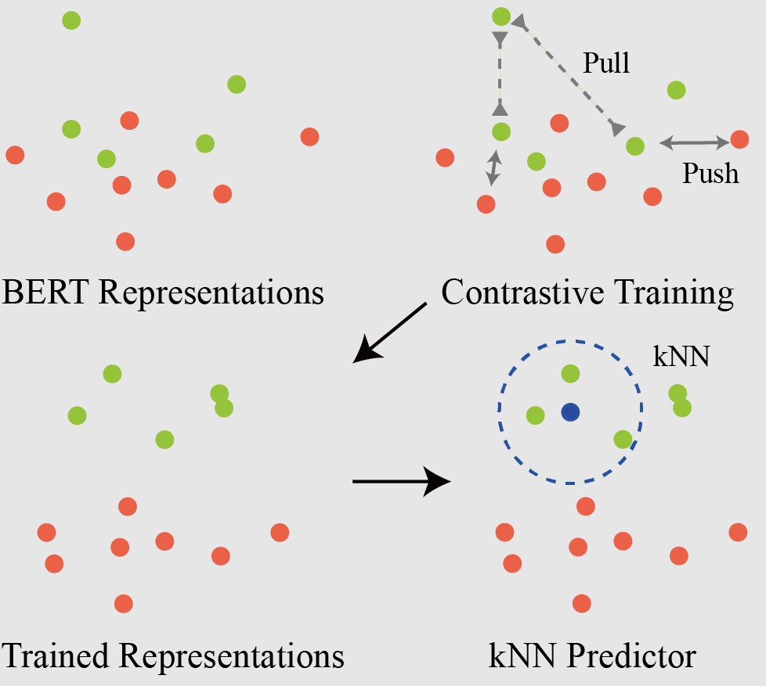
1. Introduction: Subcategory – Contrastive Learning
Contrastive Learning: learn to
Contrastive losses pull latent representations of the same-class samples close together.
Push representations of the different class samples far away
→ that helps:
Margins improvement among clusters.
Data representations become more meaningful and condense and reduces noise (because the data is more close to the anchor that represents the features of the cluster).
Significant Researches:
SimCLR
MOCO

Slide 13
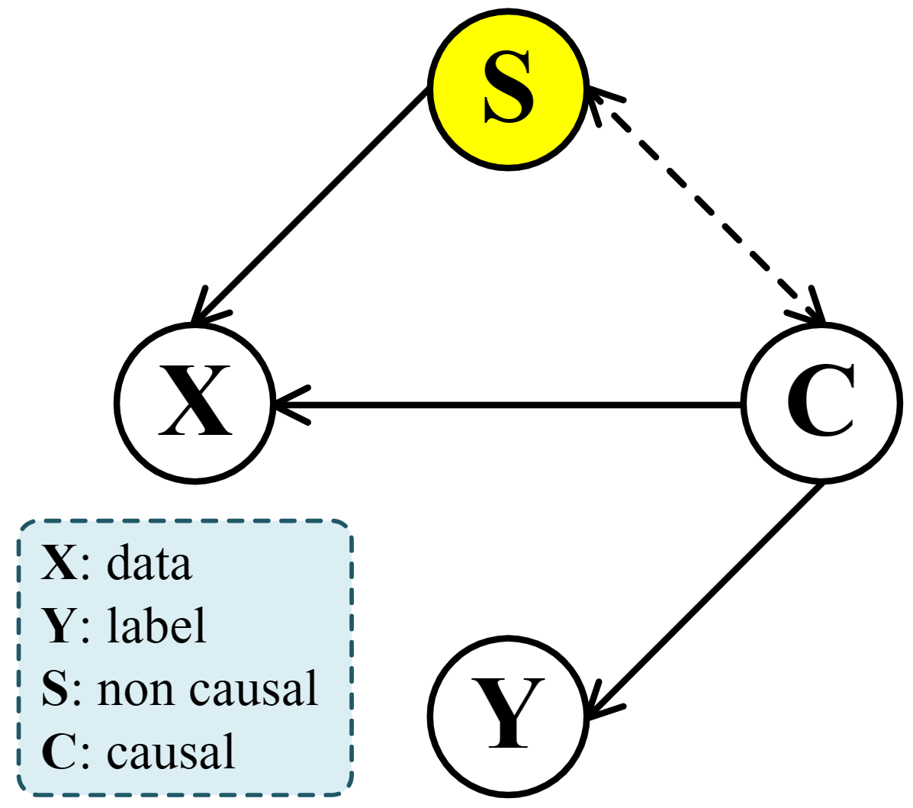
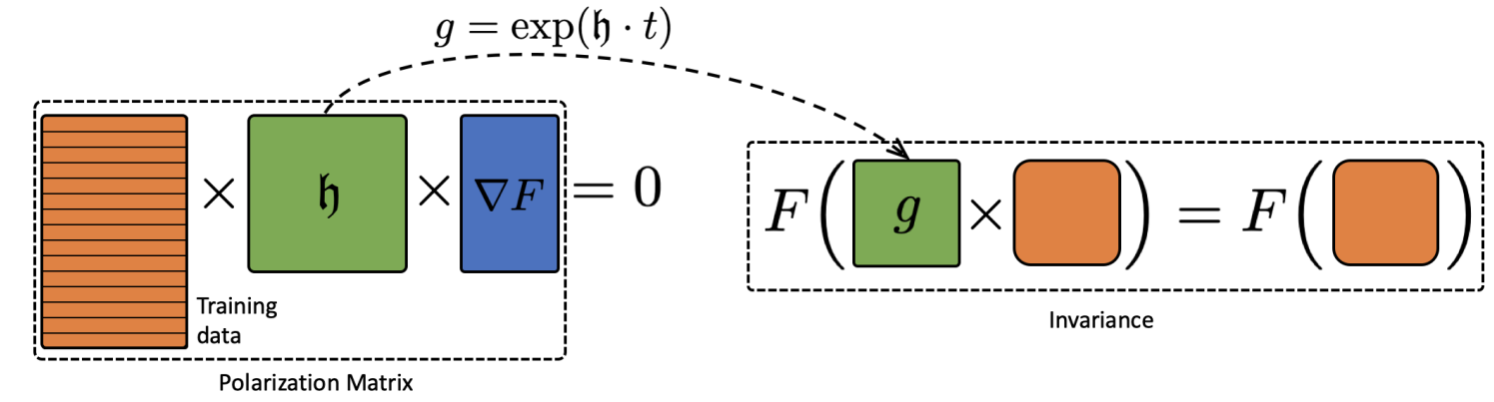
1. Introduction: Subcategory – Invariance Learning
Invariance Learning: learn the invariant representations among different data perturbations.
Non-causal part: does not lead to the ground-truth Y
Causal part: the representations that leads to the ground-truth Y
Causal part: the representations that leads to the ground-truth Y
C is invariant to Y across different X (or S)
→ Learn invariant representations C can reduces the cost of learning S
Significant Researches:
LieGG
Augerino
Laplace-GGN
ISL

Slide 14
Questionaire ^_^

